Slide 1
Digital Business Solutions
Wespac – process mining

Slide 2
Scope of data
CALL STRAT DATA
DATA WRANGLING
PROCESS MINING
Scope: Ally CS Monitoring
Date: February 15 – March 16
Unique Cases: 419
Changes: Melted the data from wide to long format
Rows: 3,042
New Features: Activity Order, Duration in sec, CountVar
Learn the shortest/longest path possible
See if other call reasons impacts how the agent more from different phases

Slide 3
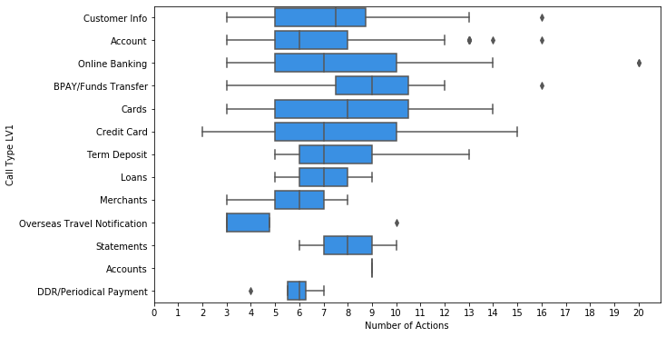
EDA
Number of actions of per call type
Call Type | count | median | std | min | max
Account | 114 | 6 | 3.0 | 3 | 16
Online Banking | 100 | 7 | 3.3 | 3 | 20
Credit Card | 99 | 7 | 3.1 | 2 | 15
Cards | 47 | 8 | 3.1 | 3 | 14
Customer Info | 18 | 8 | 3.7 | 3 | 16
Merchants | 13 | 6 | 1.4 | 3 | 8
BPAY/Funds Transfer | 8 | 9 | 3.9 | 3 | 16
Term Deposit | 5 | 7 | 3.2 | 5 | 13
DDR/Periodical Payment | 4 | 6 | 1.3 | 4 | 7
Overseas Travel Notification | 4 | 3 | 3.5 | 3 | 10
Loans | 3 | 7 | 2 | 5 | 9
Statements | 3 | 8 | 2 | 6 | 10
Accounts | 1 | 9 | Null | 9 | 9
Majority of the activities per each call that at least 3 actions with an exception to Credit Card call types.
Most calltype plays around at least 5 actions

Slide 4
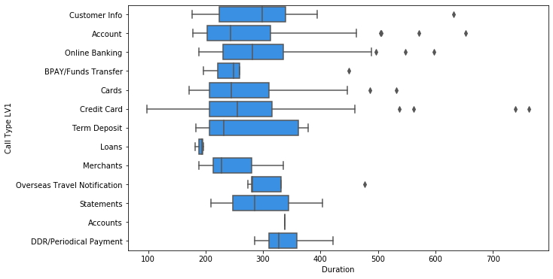
EDA
Duration of per call type
Call Type | count | median | std | min | max
Account | 114 | 244 | 86.6 | 178 | 653
Online Banking | 100 | 282 | 82.1 | 189 | 598
Credit Card | 99 | 255 | 109.1 | 98 | 763
Cards | 47 | 245 | 84.0 | 171 | 532
Customer Info | 18 | 298.5 | 104.6 | 177 | 632
Merchants | 13 | 228 | 48.5 | 189 | 335
BPAY/Funds Transfer | 8 | 248.5 | 79.0 | 196 | 449
Term Deposit | 5 | 232 | 90.9 | 183 | 378
DDR/Periodical Payment | 4 | 327.5 | 58.4 | 285 | 422
Overseas Travel Notification | 4 | 282 | 98.9 | 274 | 477
Loans | 3 | 194 | 7.6 | 182 | 196
Statements | 3 | 286 | 97.7 | 209 | 403
Accounts | 1 | 338 | Null | 338 | 338
Features of positive value are indicators of what the model sees important to predict the specific class. Negative values are indicators of what the class will not likely to be.

Slide 5
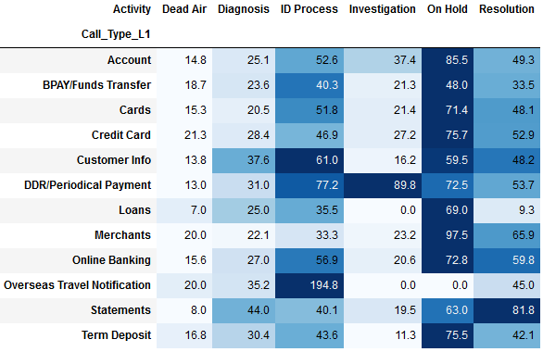
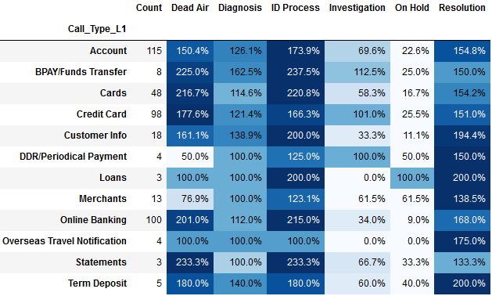
EDA
Duration and Activities per call type
Duration (mean)
Activity Composition

Slide 6
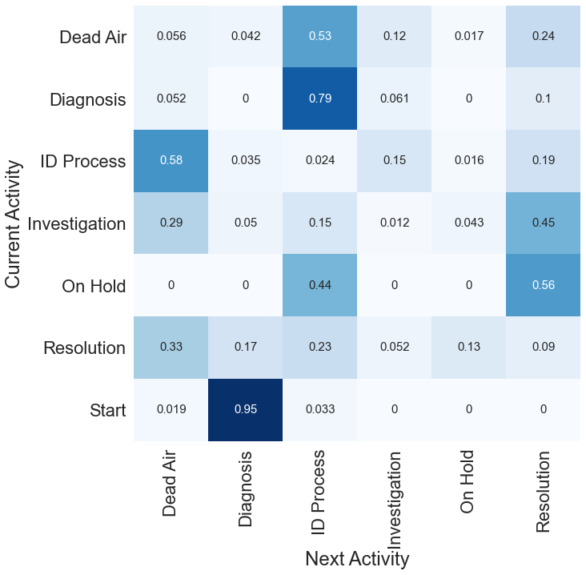
EDA
Transition from one activity to another
Majority of the calls received starts with Diagnosis follow by ID Process and from there its action may be routed to the following:
Dead Air
On Hold
Investigation
Resolution
Where the best-case scenario would be providing the Resolution or Investigation then Resolution

Slide 7
Future improvement
What are some of the data we may add to further improve the analysis

